Slide 1

Financial Performance Management RBP020L062S
Week 3
The evolution of Corporate Reporting –
Integrated Reporting

Slide 2
Learning outcomes
At the end of this session you should be able to:
Describe the evolution of corporate reporting.
Appreciate the characteristics and purposes of
sustainability reporting and integrated reporting.
To analyse recent examples of integrated reporting
practices.

Slide 3
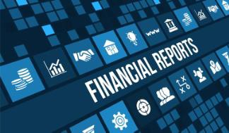
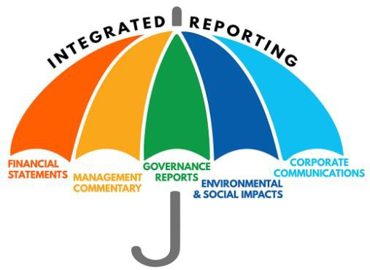
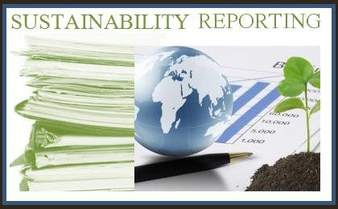
The evolution of corporate reporting

Slide 4


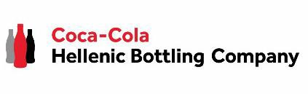
Let’s start with few examples
NOVARTIS
Reporting archive | Novartis
AXA
https://www.axa.com/en/investor/annual-
and-interim-reports-archives
COCA COLA HELLENIC
Investor Relations | Coca-Cola colahellenic.com)
HBC (coca-

Slide 5
Traditional financial reporting
A major function of corporate reporting is to provide all stakeholders with the information they require to conduct business transactions — “information function” of corporate reporting.
Accountability, transparency, future business ventures.
Confidence in investors and other stakeholders, better access to financing, lower cost of capital, better relations with customers and suppliers, greater trust from employees.
But also a “transformation function”: stakeholders are able to receive and evaluate the information to try to actively bring change where they see opportunities to influence corporate behaviour.
Source: IMA (2016)

Slide 6


Beyond financial statements
Corporate reporting has undergone various transformations to adapt to a changing landscape and to the information needs of different stakeholders.
Beyond the basic financial statements… such as management commentary, governance disclosures, and footnotes to the financial statement, external auditing, so that stakeholders could have a better understanding of the value-creation process.
Users of corporate reporting still find the information to be incomplete and inadequate in explaining the value-creation process of an organization and material nonfinancial risks.
Source: IMA (2016)

Slide 7
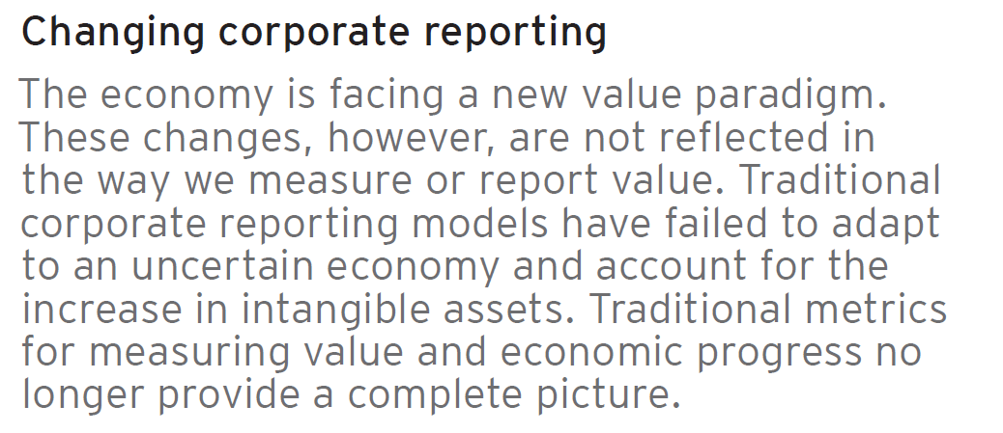
Beyond financial statements
The concept of value has changed…
Source: EY (2014)

Slide 8
Limits of the traditional reporting
Over the past 40 years, organizations have been disclosing an increasing amount of information to satisfy the demands of stakeholders.
HOWEVER…
The information provided is disjointed.
The complexity of financial reporting requires increasing technical knowledge.
The current economic, social and environmental crises are forcing us to think
differently.
The lack of regulatory framework for non-financial reports means inconsistencie.
Financial reports fail to reflect ability to create value.
The increasing role of intangibles.
Source: EY (2014)
Towards Sustainability Reporting and Integrated Reporting…

Slide 9
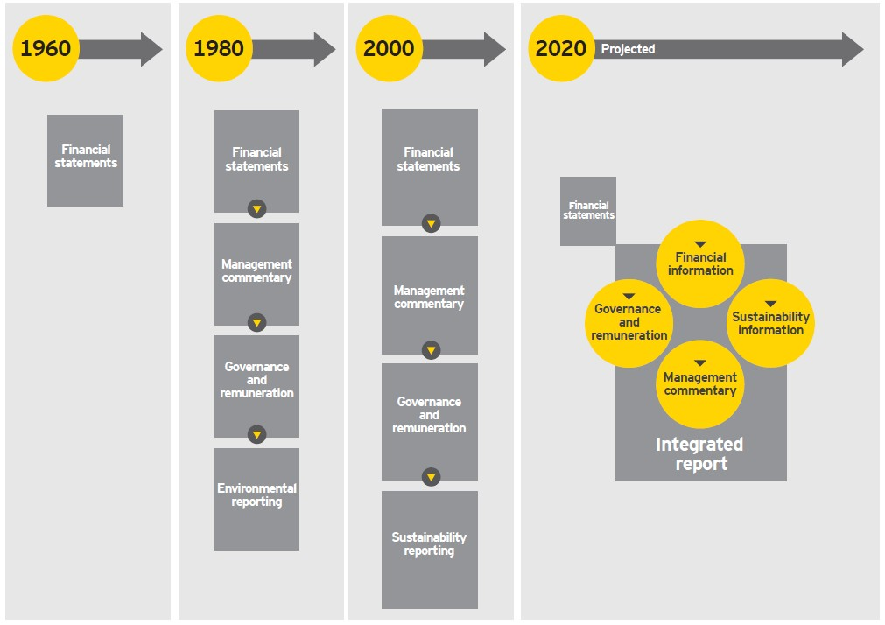
The evolution of corporate reporting
Source: EY(2014), Adapted from IIRC, Towards Integrated Reporting: Communicating Value in the 21st Century, September 2011

Slide 10
Why <IR>: More than financials
Market value – S&P 500
Source: IIRC presentation January 2014

Slide 11
Why <IR>: The reporting mismatch
Reporting content
Business value
STRATEGIC ISSUES
STRATEGY AND GOVERNANCE
FORECASTS / PLANS
IMPLEMENTATION PLANS
PAST PERFORMANCE
BUSINESS AS USUAL
Source: IIRC presentation January 2014

Slide 12
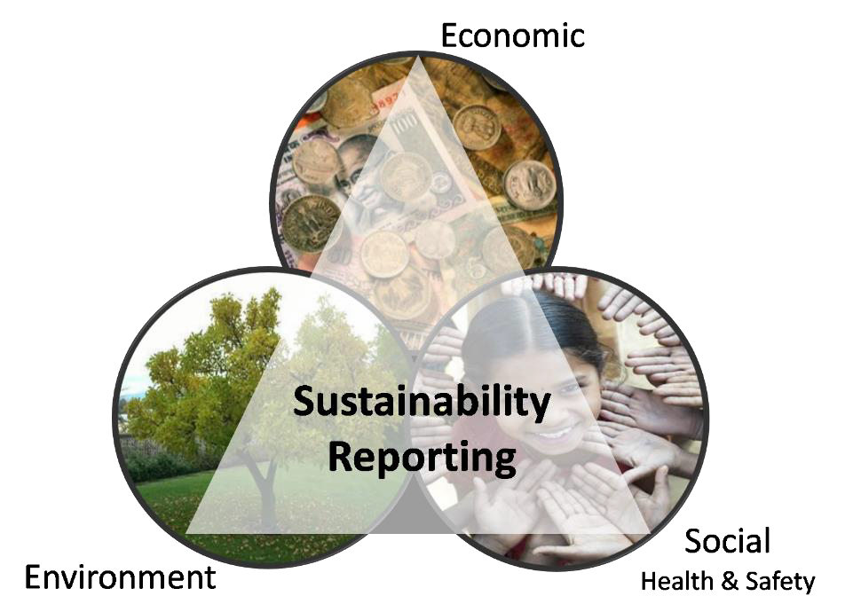
Sustainability reporting
A sustainability report is a report published by a company or organization about the economic, environmental and social impacts caused by its everyday activities.
GRI Sustainability Reporting Standards (GRI Standards) help businesses, governments and other organizations understand and communicate the impact of business on critical sustainability issues.
Environmental, Social, Governance (ESG) performance
Benefits:
Reporting not a PR exercise
Interaction with stakeholders
Transparency
Brand Management

Slide 13
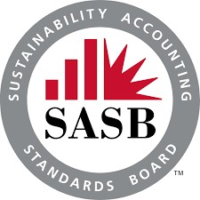
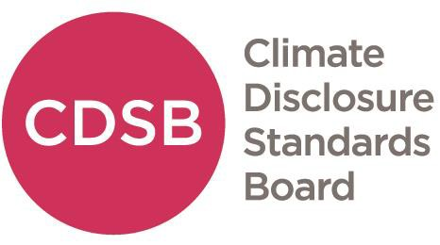
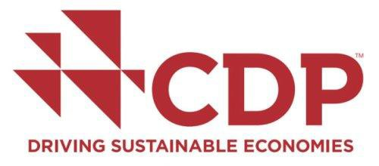

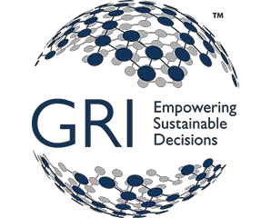
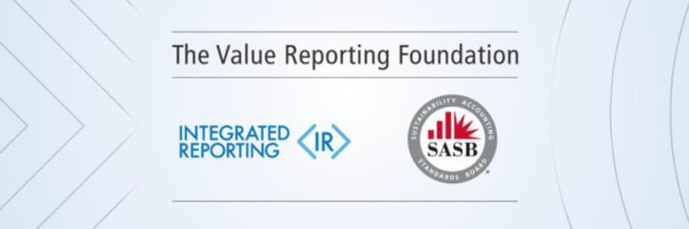
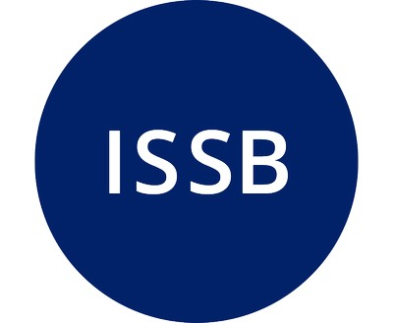
The big five/four

Slide 15

Non-financial reporting
EU Directive (Directive 2014/95/EU) requires large companies to disclose certain information on the way they operate and manage social and environmental challenges.
WHO:
WHAT:
HOW:
large public-interest companies with more than 500 employees (approximately 6,000 large companies and groups across EU)
environmental protection
social responsibility and treatment of employees
respect for human rights
anti-corruption and bribery
diversity on company boards (in terms of age, gender, educational and professional background)
companies may use international,
European or national guidelines
the UN Global Compact
the OECD guidelines for multinational enterprises
ISO 26000
Corporate Sustainability Reporting Directive (CSRD)

Slide 16
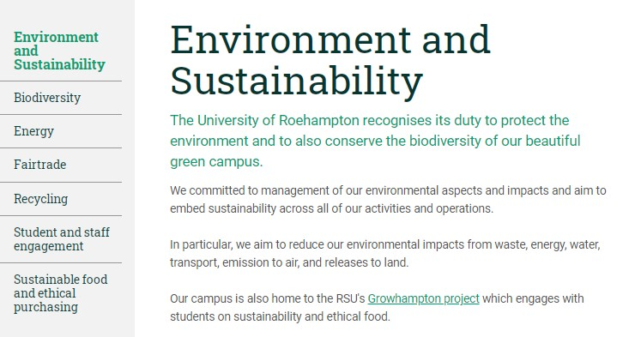
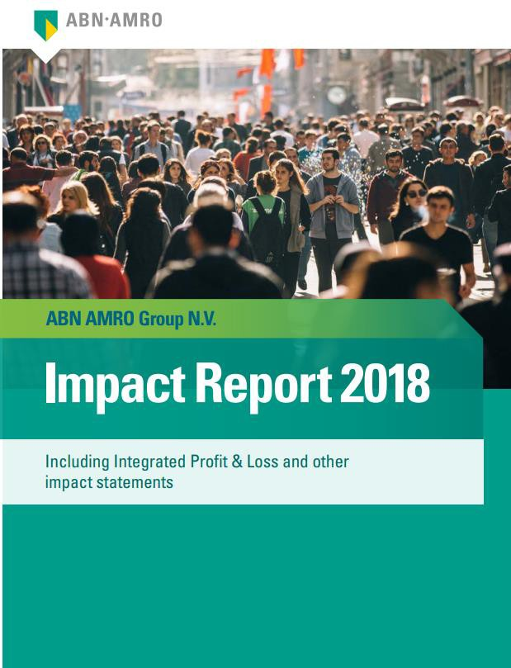
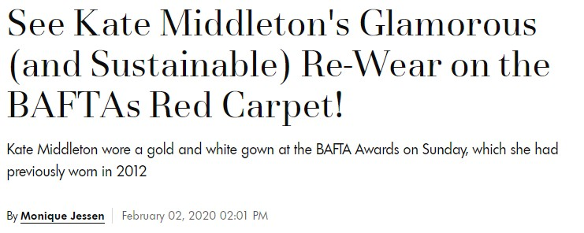

Sustainability in practice…
• …

Slide 17
Integrated reporting
The International Integrated Reporting Council (IIRC) defines integrated reporting as ‘a process founded on integrated thinking that results in a periodic integrated report by an organization about value creation over time and related communications regarding aspects of value creation’ (IIRC, 2021).
The concept of integrated reporting was introduced in South Africa in 2009 through King III, the code of corporate governance. The Johannesburg Stock Exchange adopted King III, and all listed companies are now required to “apply or explain” the King III principles, of which IR is one.
The IIRC, set up at the end of 2010, aims to create the globally accepted integrated reporting framework.

Slide 18
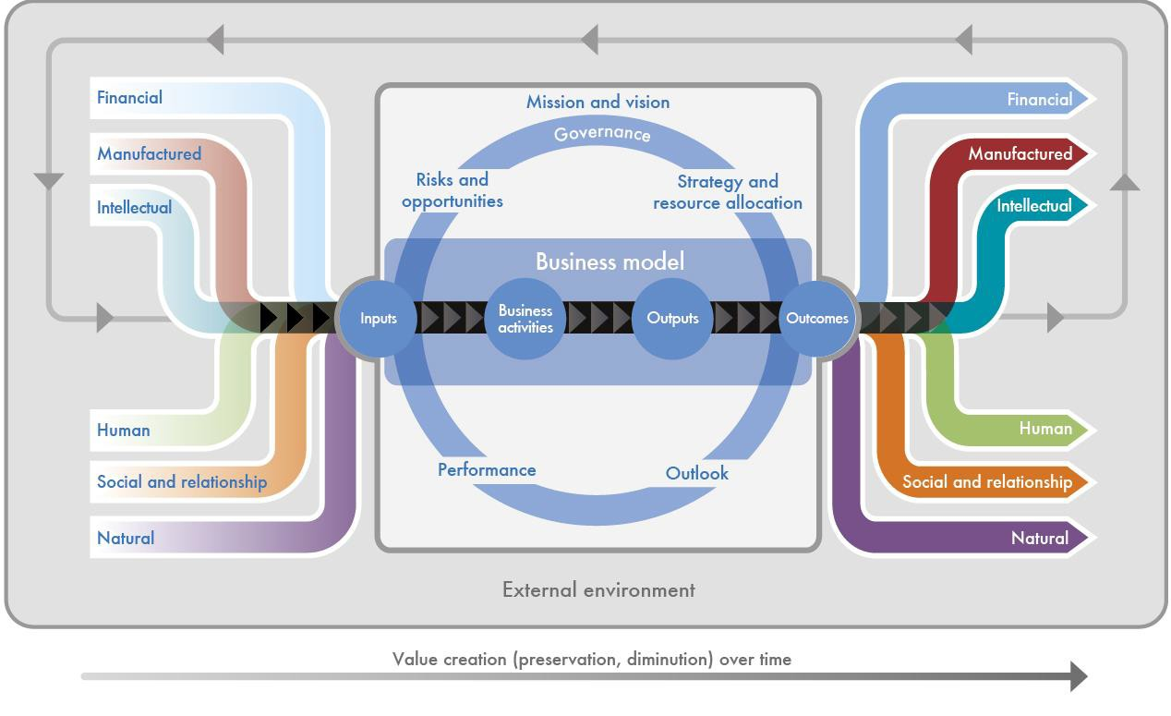
Integrated reporting
An integrated report is ‘a concise communication about how an organization’s strategy, governance, performance and prospects, in the context of its external environment, lead to the creation of value in the short, medium and long term’ (IIRC, 2021).

Slide 19
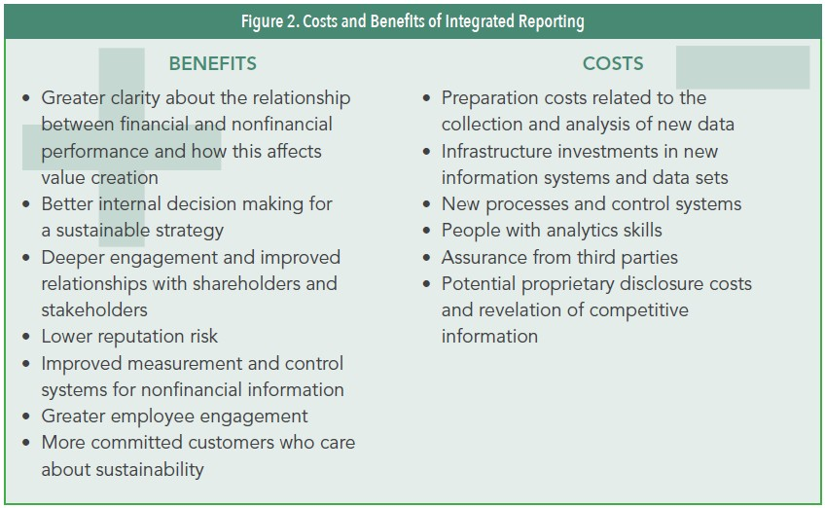
Costs and Benefits of IR
Source: IMA (2016), “Integrated Reporting. Statement on Management Accounting”

Slide 20

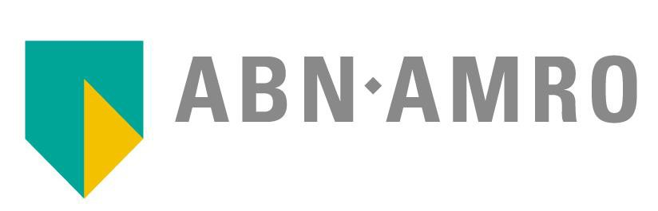

Integrated Reporting: the case of …
IBERDROLA
https://www.iberdrola.com/shareholde
rs-investors/annual-reports
ABN AMRO
https://www.abnamro.com/en/ investor-relations/financial- disclosures/index.html?from=0 1-10-2017&until=31-12-2017
ASSICURAZIONI GENERALI
https://www.generali.com/investors

Slide 21
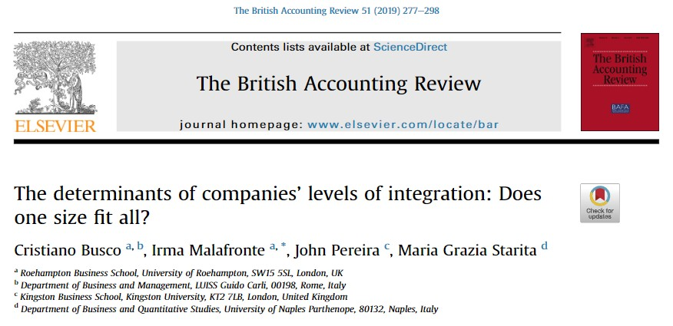
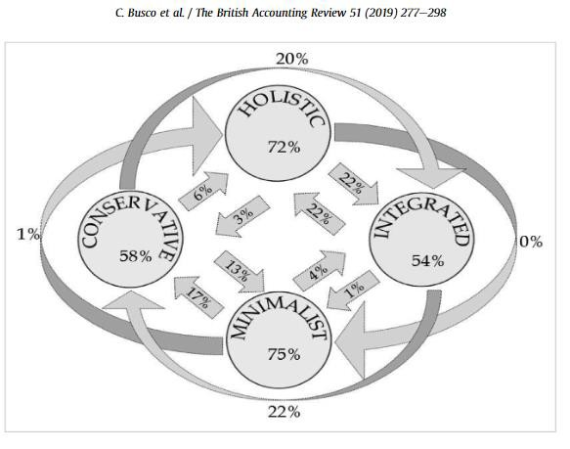
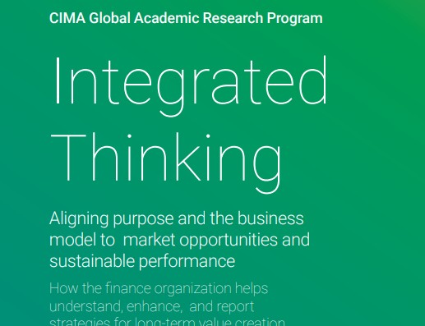
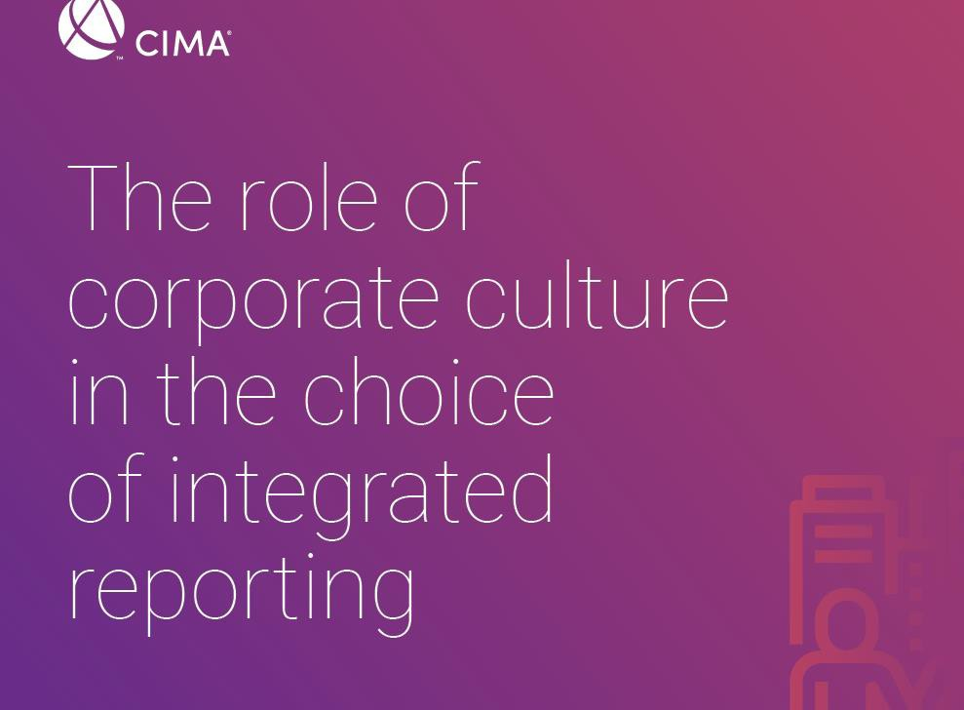
Integrated reporting in academic literature (among others)
Dr. Ir
alafronte

Slide 22

Readings
IIRC (2021). International <IR> framework. Available at International <IR> Framework
Busco, C., Malafronte, I., Pereira, J. and Starita, M.G. (2019). The determinants of companies’ levels of integration: Does one size fit all?. The British Accounting Review, 51(3), pp.277-298.
ESG Reporting Guide (2018), London Stock Exchange Group.
IMA (2016). Integrated Reporting. Statement on Management Accounting.
EY (2014). Integrated reporting. Elevating value.
Go to Explore section on Moodle and to the Share & Apply seminar

